Slide 1
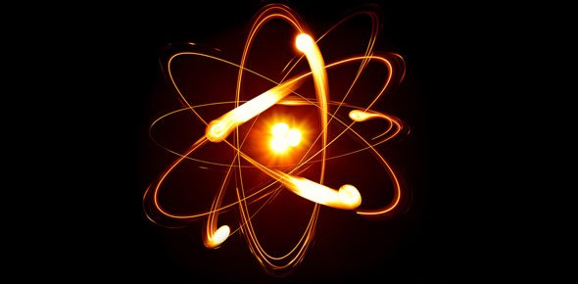
BSc. II , Subject:- Chemistry Paper – VIII, Physical Chemistry
Dr. V. V. Dhole,
SHRI CHHATRAPATI SHIVAJI COLLEGE,
OMERGA

Slide 2
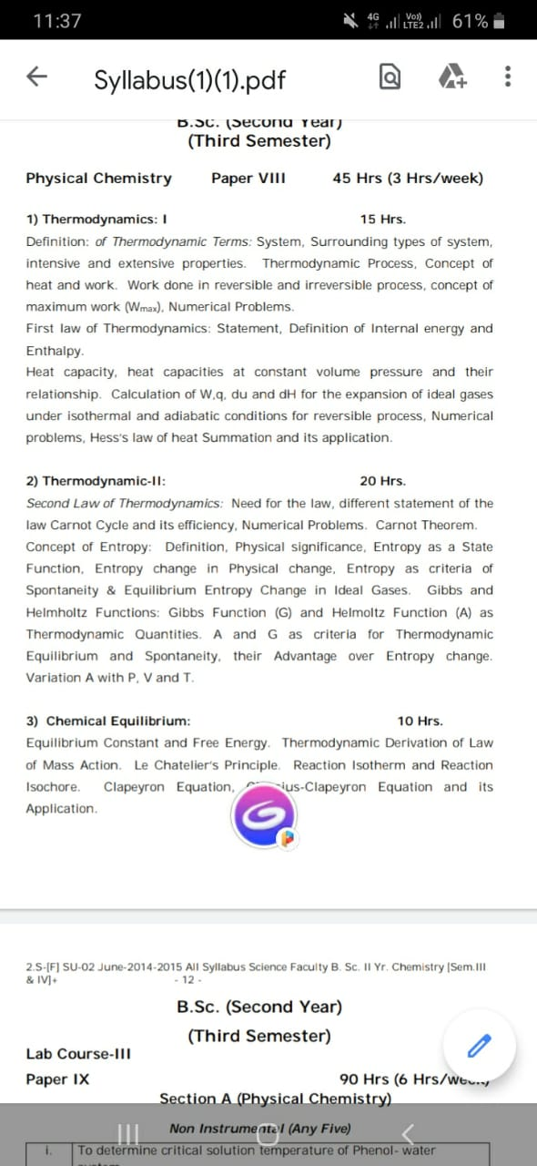

Slide 3
Chapter -I Thermodynamics
Definition of Thermodynamics is the branch of physics that deals with the relationships between heat and other forms of energy. In particular, it describes how thermal energy is converted to and from other forms of energy and how it affects matter.
The word "thermodynamics" was derived from the Greek words thermé (heat) and dynamics (force).
Basic concepts of Thermodynamics, science of the relationship between heat, work, temperature, and energy. In broad terms, thermodynamics deals with the transfer of energy from one place to another and from one form to another. The key concept is that heat is a form of energy corresponding to a definite amount of mechanical work.

Slide 17
Thermodynamic Process:

